Slide 1
Classification Graph to the Internet of Health Things Applications
Author: Evilasio Costa Junior¹
Supervisors: Rossana M. C. Andrade¹ and Leonardo S. Rocha²
¹ Group of Computer Networks, Software Engineering and Systems (GREat)
Federal University of Ceará (UFC) - Fortaleza - CE - Brazil
² State University of Ceará - Fortaleza - CE - Brazil

Slide 2
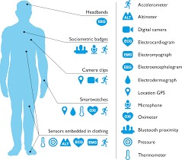
Introduction
Health and Movement Patterns
Internet of Health Things (IoHT)
IoHT applications using data of movement patterns
Correlate to sensor with Health Situations
Source Image: https://www.cbinsights.com/research/internet-of-medical-things-5g-edge-computing-changing-healthcare/

Slide 3
Motivation
Although recent studies show several IoHT applications using data of movement patterns, there are challenges to be investigated
The techniques used to relate sensor data and health states are specific, making reuse difficult.
These applications demand the use of different sensors and this makes it difficult to deal with interoperability between the different types of sensors.

Slide 4
Objective
Propose a Classification Graph as a reuse artifact that aims to relate sensors, features, intelligent classification algorithms and health states, in order to mitigate problems in the development of IoHT applications based on Movement Data, helping to identify movement patterns and correlating them with health states

Slide 5
Related Works
Notes:
- Our study began with a systematic mapping executed in 2020 that aimed to obtain an overview of recent years of research on IoHT systems based on movement data and identify trends, challenges and open questions.

Slide 6
Classification Graph
This artefact propose to model, as a graph structure, the relationship between sensors, features, classification algorithms, and situations or health states
This software artifact aims to:
Assist a development team in requirement elicitation, design, software implementation, and test steps in the development process
to build knowledge representation objects for IoHT applications. The classification algorithms in these artifact are used to predict, based on sensor data, the situations or health states

Slide 7
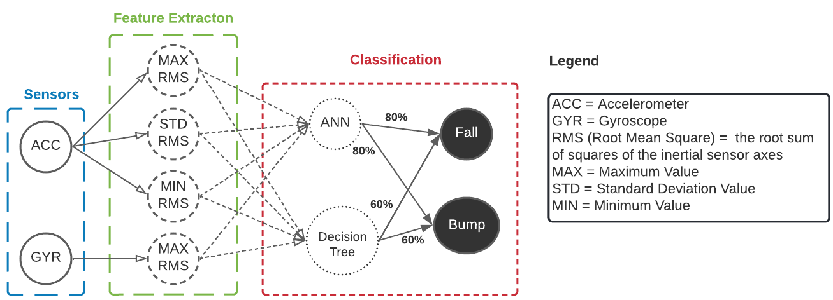
Sample of Classification Graph

Slide 8
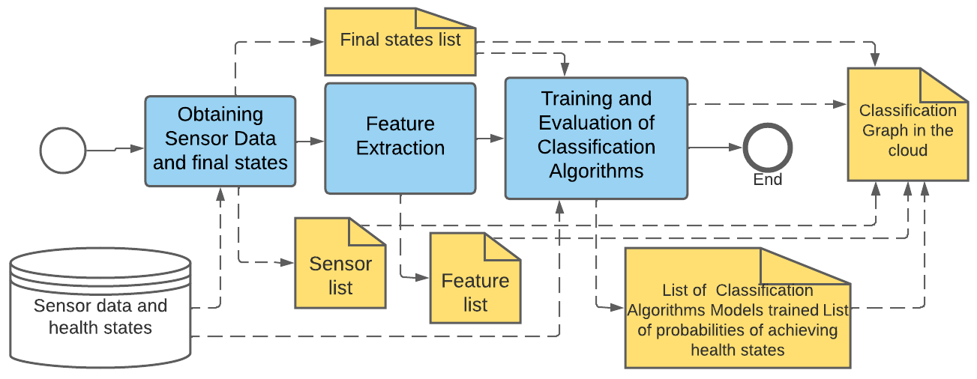
Create and Update Classification Graph

Slide 9
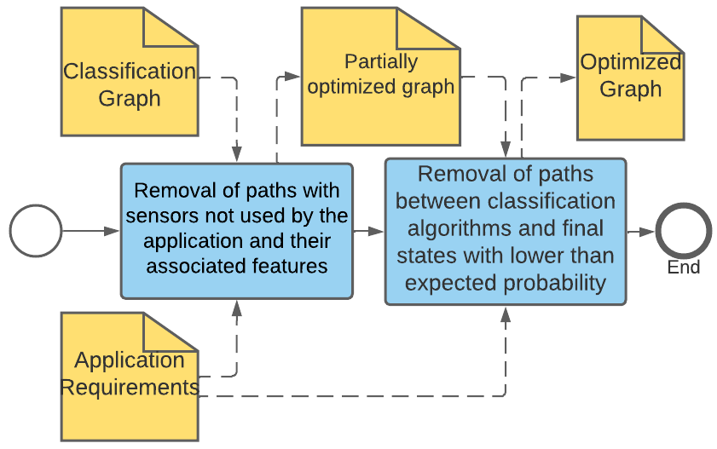
Optimize a Classification Graph

Slide 10
Evaluation
To evaluate the functionality of the graph, we created a python system on a server located in the AWS cloud that generates the classification graph and stores it in an MYSQL database or in an XML file format
We use two datasets with data to identify movement patterns:
The First Dataset¹ have two sensors (accelerometer and Gyroscope) and 18 Final States
The Second Dataset² have one sensor (accelerometer) and 13 Final States
We use three classification algorithms in the classification graph: A Artificial Neural Network (with TensorFlow Library), Decision Three and Random Forest (with Sci-kit Learn Library)
[1] I. Linhares, R. Andrade, E. Costa Junior, P. A. Oliveira, B. Oliveira, and P. Aguilar, “Lessons learned from the development of mobile applications for fall detection,” in GLOBAL HEALTH 2020, The Ninth International Conference on Global Health Challenges. ThinkMind, 2020, pp. 18–25.
[2] B. Bruno, F. Mastrogiovanni, A. Sgorbissa, T. Vernazza, and R. Za- ccaria, “Analysis of human behavior recognition algorithms based on acceleration data,” in 2013 IEEE International Conference on Robotics and Automation. IEEE, 2013, pp. 1602–1607.

Slide 11
Evaluation
We create a Web API to request the Complete or Optmized Graph
The Complete Graph and Optimized Graph generated can be download as an XML File to use by IoT applications through an API request
Link to download the complete graph using the API: http://3.86.153.243:3000/GraphRequest
We use an optimized version of this graph with only accelerometer data to run in a mobile application

Slide 12
Final Considerations
This research proposes a Classification Graph Model to assist the development of IoHT Applications based on Movement Data
A Proof of Concept of the Classification Graph System are implemented using two different datasets to evaluate the propose
As a result, the classification graph are in a XML File format was used to assist the development of an IoHT mobile application to identify movement patterns
The system code for creating the generated graph, as well as the instructions for running it on a server, can be found at: https://github.com/great-ufc/ClassificationGraphSolutionforIoHT

Slide 13
References
BAIG, M. M.; GHOLAMHOSSEINI, H.; CONNOLLY, M. J. Falls risk assessment for hospitalised older adults: a combination of motion data and vital signs. Aging clinical and experimental research, Springer, v. 28, n. 6, p. 1159–1168, 2016.
KODYŠ, M.; OLIVER, P.; BELLMUNT, J.; MOKHTARI, M. Human urban mobility classification in aal deployments using mobile devices. In:Proceedings of the 19th International Conference on Information Integration and Web-based Applications & Services. [S. l.:s. n.], 2017. p. 311–319.
BALAJI, R.; BHAVSAR, K.; BHOWMICK, B.; MITHUN, B.; CHAKRAVARTY, K.;CHATTERJEE, D.; GHOSE, A.; GUPTA, P.; JAISWAL, D.; KIMBAHUNE, S.et al.Aframework for pervasive and ubiquitous geriatric monitoring. In: SPRINGER. International Conference on Human Aspects of IT for the Aged Population. [S. l.], 2018. p. 205–230.
DÍAZ, D.; YEE, N.; DAUM, C.; STROULIA, E.; LIU, L. Activity classification in independent living environment with jins meme eyewear. In: IEEE.2018 IEEE International Conference on Pervasive Computing and Communications (PerCom). [S. l.], 2018. p. 1–9.
AICHA, A. N.; ENGLEBIENNE, G.; KRÖSE, B. Continuous measuring of the indoor walking speed of older adults living alone.Journal of ambient intelligence and humanized computing, Springer, v. 9, n. 3, p. 589–599, 2018.
KAMPEL, M.; DOPPELBAUER, S.; PLANINC, R. Automated timed up & go test forfunctional decline assessment of older adults. In:Proceedings of the 12th EAI International Conference on Pervasive Computing Technologies for Healthcare. [S. l.:s. n.], 2018. p.208–216.
SYED, L.; JABEEN, S.; MANIMALA, S.; ALSAEEDI, A. Smart healthcare framework forambient assisted living using iomt and big data analytics techniques.Future Generation Computer Systems, Elsevier, v. 101, p. 136–151, 2019.
JALAL, A.; KAMAL, S.; AZURDIA-MEZA, C. A. Depth maps-based human segmentation and action recognition using full-body plus body color cues via recognizer engine.Journal of Electrical Engineering & Technology, Springer, v. 14, n. 1, p. 455–461, 2019.
SUN, F.; ZANG, W.; GRAVINA, R.; FORTINO, G.; LI, Y. Gait-based identification for elderlyusers in wearable healthcare systems.Information Fusion, Elsevier, v. 53, p. 134–144, 2020.

Slide 14
Thank You!
Evilasio C. Junior
evilasiojunior@great.ufc.br

